Slide 1


E-Commerce Management System for Electronics
GROUP No. 15
Akhilesh Dongre - 002784651
Mihir Joshi - 001007613
Ritika Wadhwa - 001564943
Sriram Nandan Palaniswamy - 002722686

Slide 2

Objectives
Prevent duplication of products
Current stock market information (product quantities)
Increase consumer loyalty by giving discounts or vouchers to regular customers.
To extract data and provide comparable, ideal, and less expensive alternative items
To identify niches by observing the items and venues that are offered.
Keep track of sales and profits and delivery performance.
High Level Design
This database consists of a total of 14 tables.
Information about Customers, Products, Orders and Shipments is contained in their respective tables.
Information about Discount, Product reviews, Supplier, Shipping company and Payments is contained in their respective tables.
The many-to-many relationships between are depicted by the associative entities like Product_Discount_Relation, Product_Supplier_relation and Order Quantity.
This design, while increasing the number of tables, reduces the complexity of the database and makes it easier to query data.

Slide 3
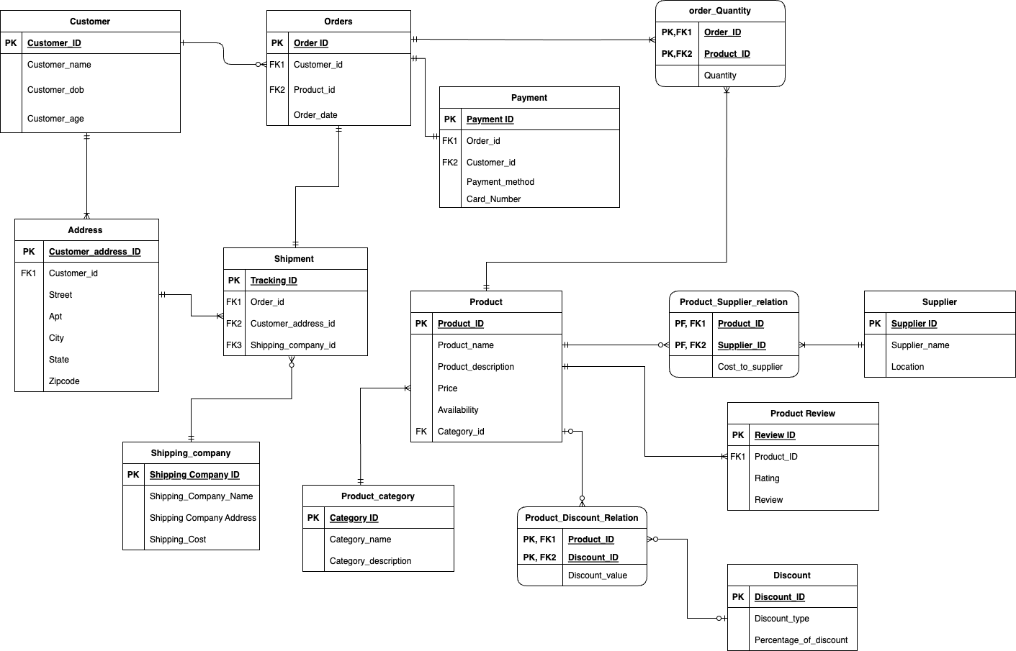
Final ERD

Slide 4
Database Objects
DDL & Encryption:
CREATE PAYMENT TABLE
--Create database master key
CREATE MASTER KEY ENCRYPTION BY PASSWORD = 'YourPassword123';
--Create a certificate to protect the symmetric key
CREATE CERTIFICATE MyCertificate WITH SUBJECT = 'Certificate for TDE';
--Create the symmetric key with an algorithm
CREATE SYMMETRIC KEY MySymmetricKey WITH ALGORITHM = AES_256 ENCRYPTION BY CERTIFICATE MyCertificate;
CREATE TABLE [dbo].[payment](
[payment_ID] int NOT NULL,
[order_ID] INT NOT NULL,
[customer_ID] int NOT NULL,
[payment_method] [char](20) NOT NULL,
[card_number] varbinary(256) DEFAULT ENCRYPTBYKEY(KEY_GUID('MySymmetricKey'), 'card_number'),
CONSTRAINT [payment_PK] PRIMARY KEY([payment_ID] ASC),
CONSTRAINT [payment_FK_1] FOREIGN KEY (customer_ID) REFERENCES customer(customer_ID),
CONSTRAINT [payment_FK_2] FOREIGN KEY (order_ID) REFERENCES orders(order_ID))
Views:
Retrieve the top 3 best-selling products
CREATE VIEW BestSellingProducts
AS
SELECT TOP 3 p.Product_ID, p.Product_Name, SUM(od.Quantity) AS TotalQuantitySold FROM Product p
JOIN order_qty od ON p.product_ID = od.Product_ID
GROUP BY p.Product_ID, p.Product_Name
ORDER BY TotalQuantitySold DESC
GO
Stored Procedures:
Stored procedure 1: Find orders for given customer
CREATE PROCEDURE GetCustomerOrders
@CustomerId INT,
@CountOrders INT OUTPUT
AS BEGIN
SELECT @CountOrders = COUNT(*) FROM Orders --
WHERE Customer_Id = @CustomerId
SELECT order_ID, order_date, product_ID, customer_ID FROM Orders
WHERE customer_ID = @CustomerId
END
GO
Triggers:
DML trigger preventing under age customers
CREATE TRIGGER [dbo].[prevent_underage_customers]
ON Customer
AFTER INSERT
ASBEGIN
IF EXISTS(SELECT 1 FROM inserted WHERE DATEDIFF(YEAR, customer_DOB, GETDATE()) < 18)
BEGIN
RAISERROR('Cannot add customer under 18 years old', 16, 1);
ROLLBACK TRANSACTION;
END;
END;
GO

Slide 5
Data Population
INSERT scripts:
Inserting value into Payment
OPEN SYMMETRIC KEY MySymmetricKey
DECRYPTION BY CERTIFICATE MyCertificate;
INSERT INTO payment VALUES (9937, 0001, 0003, 'Credit Card', ENCRYPTBYKEY(KEY_GUID('MySymmetricKey'), convert(varbinary,'9788854623')))
INSERT INTO payment VALUES (2693, 0002, 0005, 'Debit Card', ENCRYPTBYKEY(KEY_GUID('MySymmetricKey'), convert(varbinary,'9788890809')))
INSERT INTO payment VALUES (8875, 0003, 0003, 'Credit Card',ENCRYPTBYKEY(KEY_GUID('MySymmetricKey'), convert(varbinary,'9398430809')))
INSERT INTO payment VALUES (9236, 0004, 0009, 'Account Transfer',ENCRYPTBYKEY(KEY_GUID('MySymmetricKey'), convert(varbinary,'7898780809')))
INSERT INTO payment VALUES (4357, 0005, 0003, 'Account Transfer',ENCRYPTBYKEY(KEY_GUID('MySymmetricKey'), convert(varbinary,'9898865409')))
INSERT INTO payment VALUES (9754, 0006, 0007, 'Debit Card',ENCRYPTBYKEY(KEY_GUID('MySymmetricKey'), convert(varbinary,'6728890823')))
INSERT INTO payment VALUES (1134, 0007, 0010, 'Credit Card',ENCRYPTBYKEY(KEY_GUID('MySymmetricKey'), convert(varbinary,'9896654329')))
INSERT INTO payment VALUES (7643, 0008, 0008, 'Credit Card',ENCRYPTBYKEY(KEY_GUID('MySymmetricKey'), convert(varbinary,'9898865472')))
INSERT INTO payment VALUES (4986, 0009, 0004, 'Debit Card',ENCRYPTBYKEY(KEY_GUID('MySymmetricKey'), convert(varbinary,'7898890899')))
INSERT INTO payment VALUES (7665, 0010, 0002, 'Account Transfer',ENCRYPTBYKEY(KEY_GUID('MySymmetricKey'), convert(varbinary,'6798890887')))

Slide 6
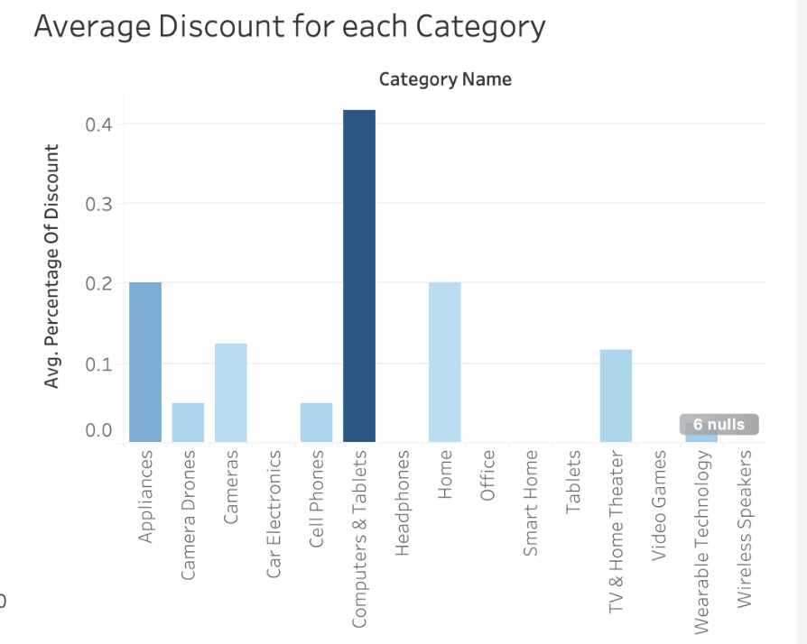
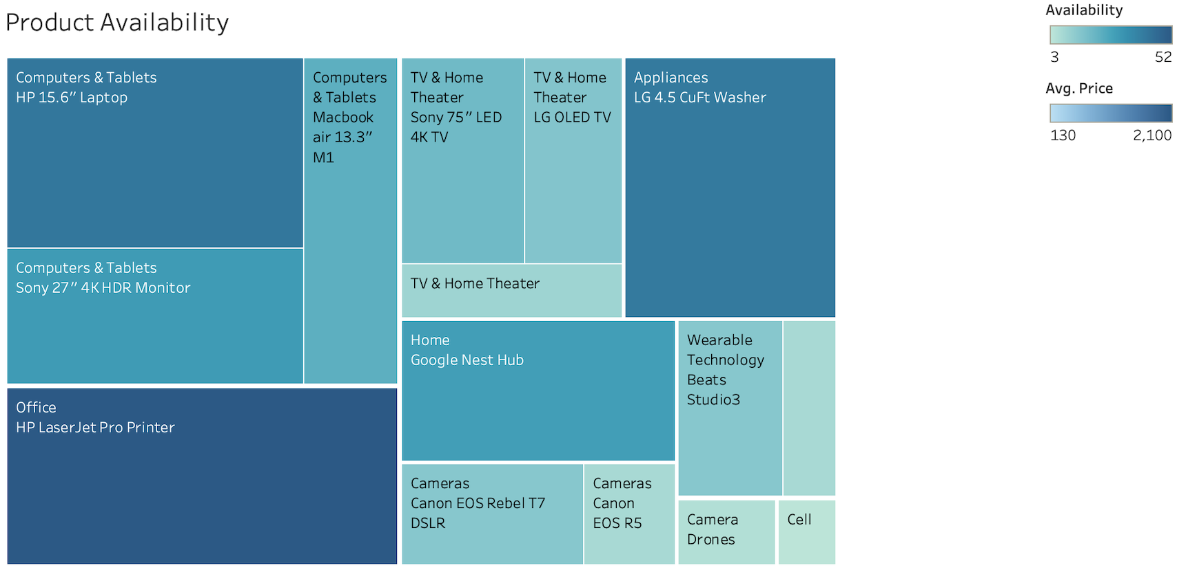
Visualizations

Slide 7
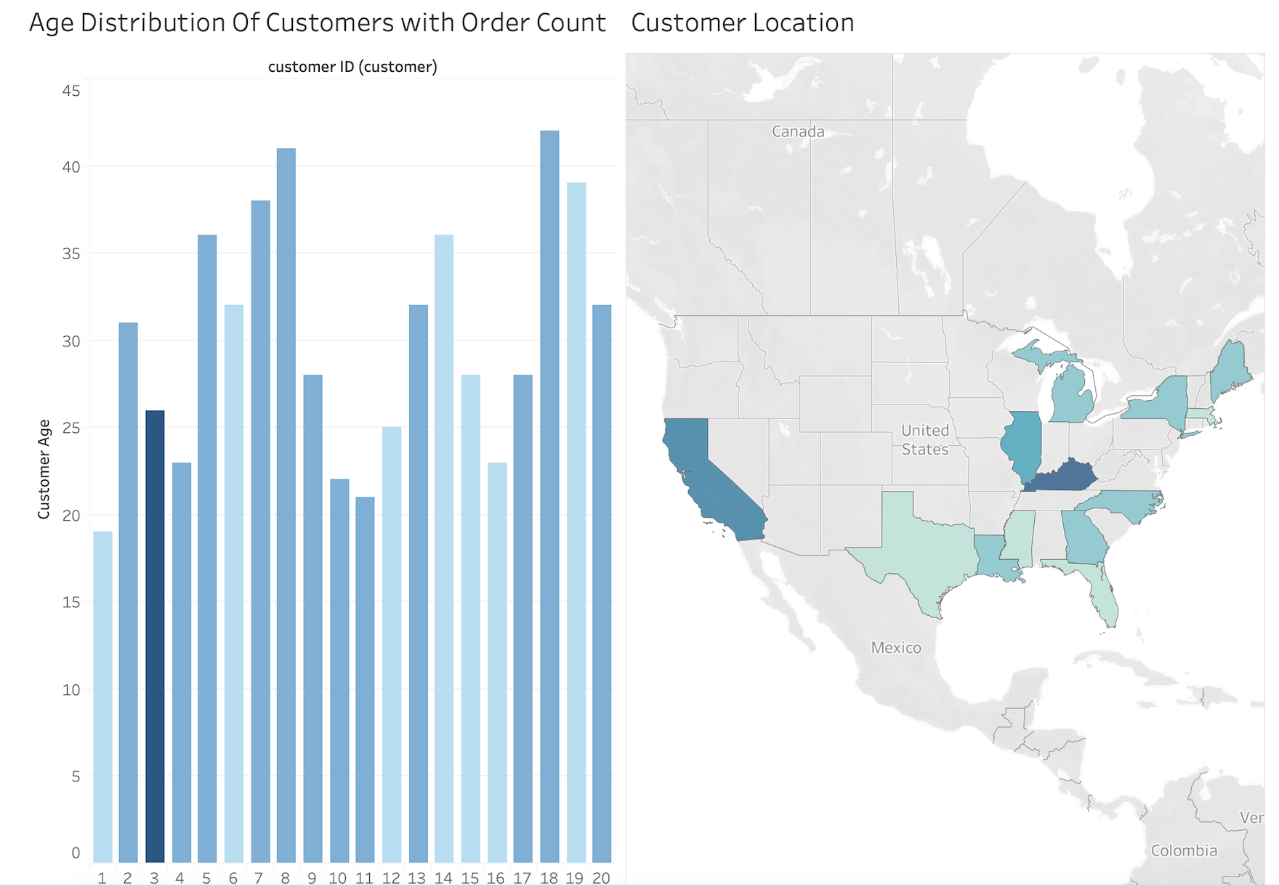
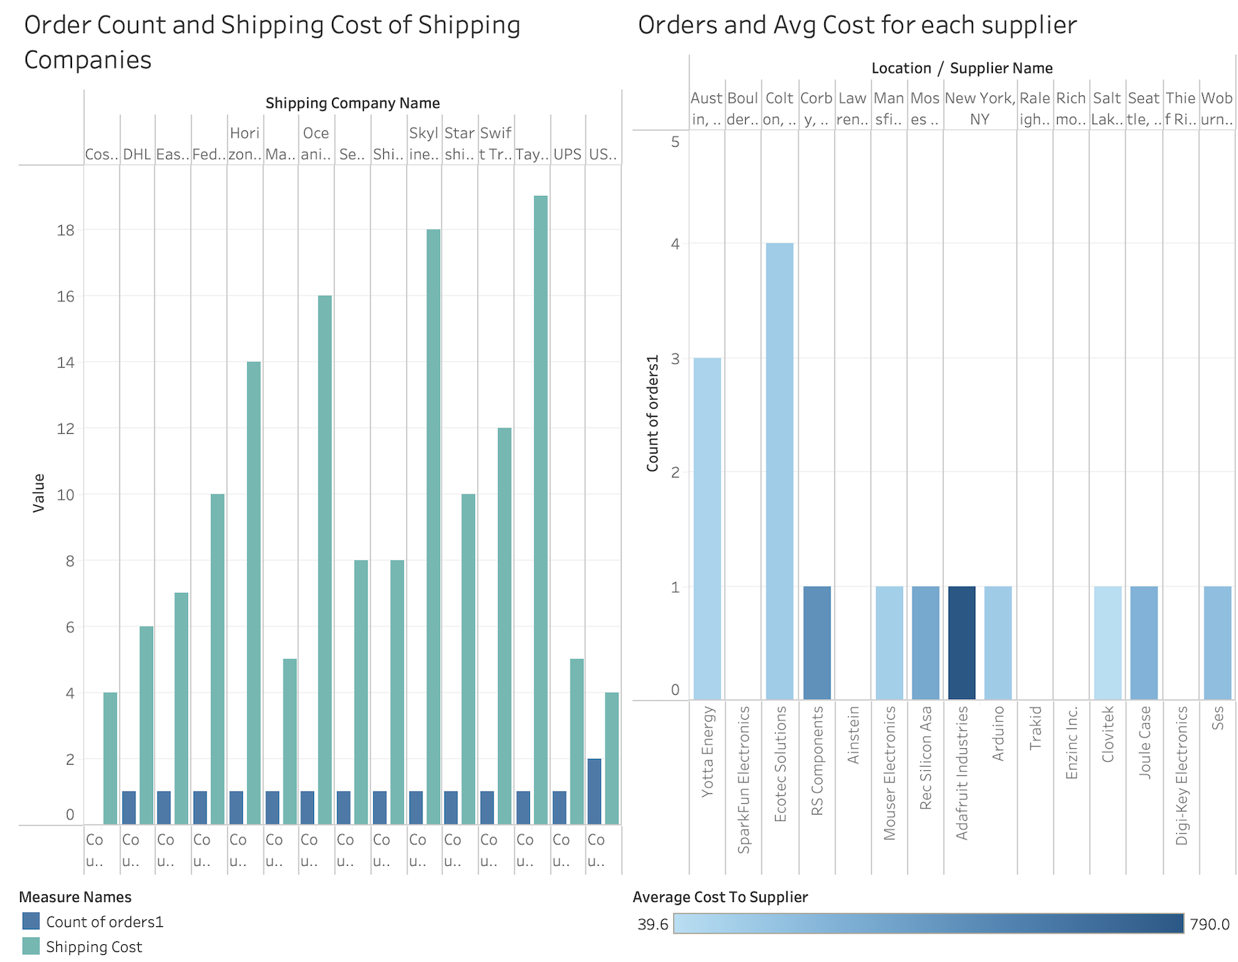
Visualizations

Slide 8
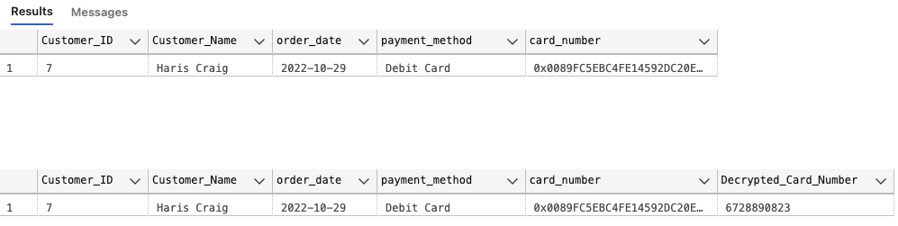
Demo
--Demo_1
SELECT o.customer_ID,p.product_ID,p.product_name, oq.QUANTITY,p.price, d.percentage_of_discount, oq.quantity*(p.price-percentage_of_discount*p.price) as "Total Price" from [Orders] o
JOIN order_qty oq on o.order_ID = oq.order_ID
JOIN product p on oq.product_ID = p.product_ID
JOIN product_discount_relation pd on p.product_ID = pd.product_ID
JOIN discount d on pd.discount_ID = d.discount_ID
WHERE customer_ID = 0005
–Demo 2 for encryption and Decryption
SELECT c.Customer_ID, c.Customer_Name, o.order_date, py.payment_method, py.card_number FROM customer c
join orders o on c.customer_ID = o.customer_ID
JOIN payment py on py.order_ID = o.order_ID
WHERE c.customer_ID = 7;
--Decrypted Table
OPEN SYMMETRIC KEY MySymmetricKey
DECRYPTION BY CERTIFICATE MyCertificate;
SELECT c.Customer_ID, c.Customer_Name, o.order_date, py.payment_method, py.card_number, CONVERT(varchar, DecryptByKey([card_number])) as "Decrypted_Card_Number" FROM customer c
join orders o on c.customer_ID = o.customer_ID
JOIN payment py on py.order_ID = o.order_ID
WHERE c.customer_ID = 7;
Thank You

